Slide 1
SAFETY ASPECTS OF MEDICAL INSTRUMENTS

Slide 2
INTRODUCTION
In today age electrical and electronic equipments are widely used in hospitals.
Therefore electric shocks ,burns and fire hazards may occur while using these instruments.

Slide 3
Effects of electric current on human body
1. Psychological Effect:
When a person feels that a current is flowing through his body then this level is called perception of electric current.
Threshold of perception of electric current
For DC it is about 5 to 10 mA
For AC it is about 1 to 10 mA at 50hz
Note: Shock perception decline as frequency increases and disappear at frequencies above 15-20 Khz.

Slide 4
2. Physiological Effect:
There are differnet physiological effect s of electric current on human body
Threshold of perception
Let go current
Physical injury and pain
Ventricullar fibrillation
Myocardial contraction
Burns and physical injury

Slide 5
SHOCK
An electric shock is unwanted or unnecessary physiological response of body to the current which accidently flow through the body.
It may cause cellular depolarization and muscular contraction and tissue injury.
So a shock occur when a current flow through body.

Slide 6
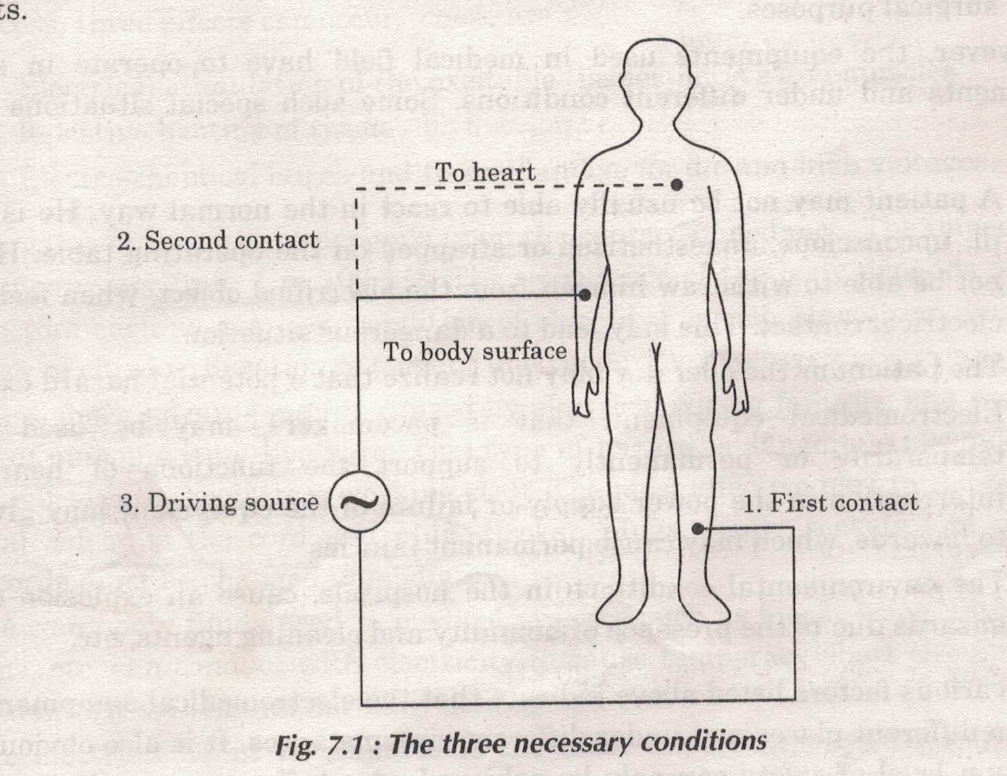
How a shock can occur
For a current to flow through two contacts must be provided on the body with a voltage source which can drive current in to the body.
The physiological effect of shock depends on position of contacts.
When both contacts are on surface of body then then effect is less dangerous and the shock is called macro current shock.
When second contact is applied directly to heart then effect is severe and can lead to dangerous situation and the shock is called micro current shock.

Slide 7
TYPES OF SHOCKS
1. Gross shock or macro current shock
2. Micro current shock

Slide 8
Gross Shock
Gross shock caused due to accidental contact of body part with electric wiring and the current flow through the skin of the body.
The value of current depends upon contact impedance of body (1 to 100 Kohm) which further depends upon other factors such as age, sex , condition of skin, frequency of current, duration of current etc.
This shock mainly occur due to electric wiring failure and may lead a shock to patient as well as doctor and working staff.

Slide 9
Effect of Gross Shock
(i) electrical stimulation of excitable tissue nerves and muscles.
(ii) Resistive heating of tissues
(iii) Electro-chemical burns and tissue damages for dc and high voltages.

Slide 10
Different Value of gross shock currents and its effect
Gross Shock Current (1 second contact) | Physiological Effect
1 mA | Threshold of feeling, tingling sensation
10-20 mA | ‘Can not let go’ lead to sustained muscular contraction
100-300 mA | Ventricular Fibrillation

Slide 11
Micro Current Shock
If the current directly flow inside the body through arterial system then the shock produced to the body is termed as micro current shock.
The amount of current required to produce this shock is vary small.
It results due to
(i) Leakage current in line operated instruments.
(ii) From voltage differences between grounded conductive surfaces due to large currents in the grounding system.

Slide 12
Effect of Micro Current Shock
A value of 50 micro ampere continuous current can cause
Ventricular Defibrillation
Heart Failure and leads to death

Slide 13
Maximum permissible current through heart versus frequency

Slide 14
Leakage Current
It is an inherent flow of non-conventional current from the live electrical parts of an instrument to the accessible metal parts.
Leakage currents usually flow through insulation and through the third wire connected to ground.
These are created due to development of capacitance between two conductors separated in space.

Slide 15
Types of Leakage Current
(i) Enclosure Leakage Circuit Current:- The current which flow from enclosure surface through a person |(in contact with accessible part of the enclosure) to earth .
(ii) Earth Leakage Current:- It is the current which flow in normal condition to earth from the main parts of an apparatus via the earth conductor.
(iii) Patient Leakage Current:- The patient leakage current is the current which flow through the patient from or to the applied part of patient circuit.
This occur due to difference in voltages of power ground and earth ground.

Slide 16
Precautions to minimize electric Shock Hazards
Use three wire power cords for all instruments/appliances.
Periodically check ground wire continuity.
No other apparatus should be put where the patient monitoring system is connected.
Connectors and probes should be standardized.
Operating instructions should be permanently displayed.
Working staff should be trained
Mechanical construction of apparatus should be such that it does not injure the staff or patient.

Slide 17
Testing of Biomedical Equipments
Testing of biomedical equipments is necessary to prevent any shock and damage to the patients. Following methods are used to test biomedical equipments.
1. Chassis/Body Leakage Current Measurement:
In this method a power supply using adapter is given to equipment. Grounding is interrupted for the leakage current to flow through the measuring instrument.
This leakage current is measured using ac micrometer.
The value of leakage current should not exceed 500 μA if equipment not in contact with patient and not exceed 100 μA if in contact.

Slide 18
Testing of Biomedical Equipments
2. Electrical Safety Analyzer: Electrical safety of equipment is checked using multi meter or using automatic measurement system .Various test are available
Mechanical Testing of electrical outlets.
Electrical testing of outlets
Testing of grounding system in patient care unit.

Slide 19
Testing of Biomedical Equipments
3. Leakage Current in Patient Leads: Patient Leakage current is measured by connecting the ammeter between earth and one of the patients input leads . It is measured under following conditions.
Combined lead leakage test.
Individual lead leakage test.
Paired lead leakage test.
Leakage with line voltage on leads.

Slide 20
Testing of Biomedical Equipments
4. Ground Continuity Test:
The ground wire circuit is checked with an ohm meter or earth tester called meggar while the equipment is unplugged.
The resistance between the ground pin of the plug and the equipment body should not exceed 0.15 Ω.
This ground test find if there is any break in ground wire or if connection is bad or corroded.

Slide 21
Methods of accident prevention or Special Design for Safety Consideration.
Reliable Earthling Or Grounding
Double Insulation
Protection by using low voltage
Ground Fault Circuit interrupter
Cord Storage Department

Slide 22
Safety Standards
The International Electro Technical Commission (IEC) has issued a guidelines standard IEC 601 for safety of medical equipments.
Based on IEC document the BIS ( Bureau of Indian Standard) has issued IS:8607 standard to cover general and safety requirement of electro medical equipments
The standard have 8 parts

Slide 23
IS: 8607 Stanards
Part 1: General
Part 2: Protection against electric shock
Part 3: Protection against mechanical hazards
Part 4: Protection against unwanted radiations
Part 5: Protection against explosions hazards.
Part 6: Protection against excessive temperature.
Part 7: Construction
Part 8: Behavior

Slide 24
Standard of BIS
BIS also issue some other standards these are
IS: 7583 Radio frequency Apparatus
IS: 8048 Electro Cardio Graph
IS: 8585 Electro myo graph

